Slide 1
Big Data in the Cloud

Slide 2
Class Objectives
By the end of today’s class, you will:
Explain why natural language processing (NLP) is necessary for a big data tool kit.
Apply transformations resulting from NLP data processing to PySpark DataFrames.
Explain and utilize PySpark text-processing methods like tokenization, stop words, n-grams, and term and document frequency.
Describe example steps in an NLP data processing pipeline.

Slide 3
Natural Language Processing

Slide 4
What Is NLP?
Natural language processing (NLP) is a field of study combining linguistics and computer science in order for computers to interact with natural (human) language.

Slide 5



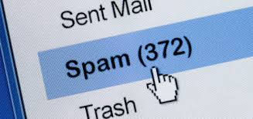
How Is NLP Used?
Spell checkers
Virtual assistants like Siri, Alexa, and Google Home
Spam filters
Virtual translations
Handling unstructured data from tweets and Facebook posts

Slide 6



Big Data + NLP
Most industries have large quantities of textual data that can’t be manually processed in an efficient way.
Law: Research, notes, documents, records of legal transactions,
governmental information
Medical Research: Patient information and history, clinical notes, symptoms
Stock Market Analysis: Company disclosures, news articles, report narratives

Slide 7
A Few NLP Applications
Text Classification
Classifying statements as subjective/objective or positive/negative
Finding the reading level or genre of a text
Information Extraction
Finding a diagnosis from doctors’ notes; identifying names of individuals from a witness statement
Document Summarization
Generating a headline or abstract for a document
Complex Question Answering
Answering a question about a subject given resources or a document on that subject

Slide 8
…But NLP Is Hard
Humans intuitively interpret natural language, but even we aren’t great at it all the time.
Natural language is:
Contextual: The meaning of text depends on the situation, speaker, and listener.
Ambiguous: Words can have multiple meanings and mean different things in different contexts.
Nonstandard: There is no general set of rules, especially across dialects, groups, etc.

Slide 9
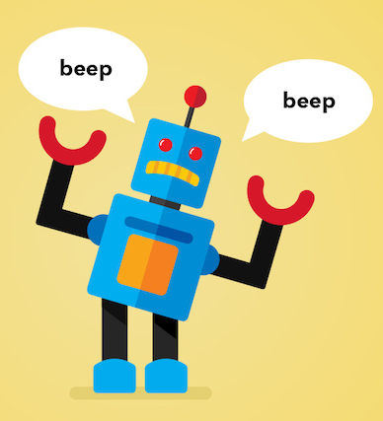
Natural Languages vs. Computer Languages
Computer languages (programming languages) are:
unambiguous
based on mathematical logic
designed to encode a very specific set of instructions
To bridge the gap between natural language interpretation and computer processing, text data must be parsed, organized, and/or encoded. In other words, it must be converted to numbers.

Slide 10
Utilizing an NLP Pipeline
Basic NLP Data Pipeline
Raw Text
Tokenization
Stop Words Filtering
TF–IDF
Machine Learning
Since NLP is very complicated, it is helpful to break the process down into smaller steps.
Each module completes a separate task.
The output data from one step becomes the input data for the next step.
High-level tasks build on low-level tasks.
This pipeline allows evaluation and refinement of each task as needed.
An NLP pipeline is similar to an ML dataset, which may require preprocessing such as encoding or scaling before fitting to a model. However, scaling and encoding can sometimes be done independently.

Slide 11
Tokenization

Slide 12

What Is Tokenization?
Tokenization is the process of segmenting running text into words, sentences, or phrases.
Text needs to be segmented into units in order for any processing to be done.
A token is a group of characters that have meaning. A token can be a word, sentence, or phrase.
Characters such as punctuation are sometimes discarded.
Tokenization is similar to the .split() method in Python.
Sentence segmentation and tokenization are often the first steps in an NLP pipeline.
Let’s eat, Grandpa!
[”let’s”, “eat”, “grandpa”]

Slide 13
Stop Words Removal

Slide 14
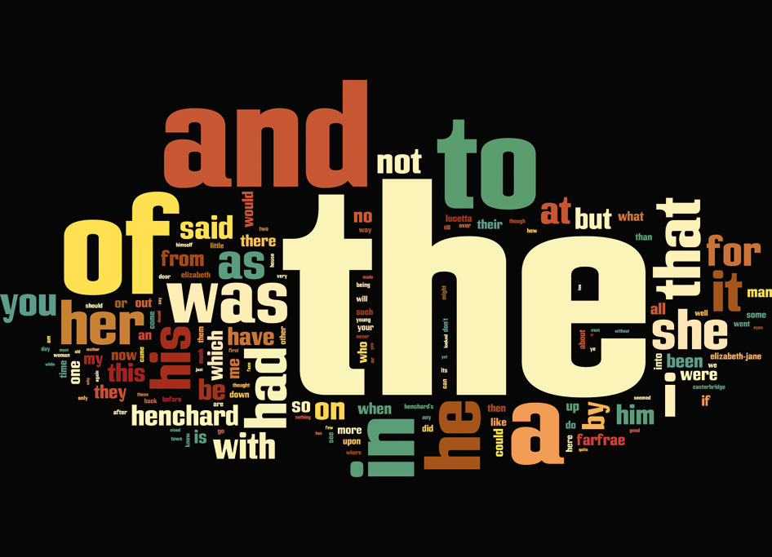
What Are Stop Words?
Stop words are words that are useful for grammar and syntax but don’t contain any important content.
Generally, stop words are the most commonly used words in a document.
Examples: this, to, the, a, there, an
Since stop words don’t distinguish between relevant and irrelevant content, they are often removed.

Slide 15
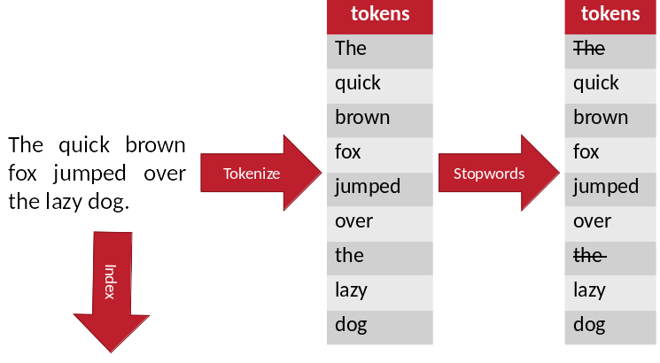
Stop Words in a Pipeline

Slide 16
Term Frequency– Inverse Document Frequency

Slide 17

What Is TF–IDF?
TF–IDF is a measure intended to reflect the importance of a word in a text.
Term Frequency (TF):
How many times a word appears in a document
Inverse Document Frequency (IDF):
log (total number of documents/number of documents containing target word)
The more documents that include the term, the lower the IDF score will be.
TF–IDF is the product of the TF score and IDF score. TF drives up the score, but IDF will bring the score down if the word occurs in all or many documents.

Slide 18
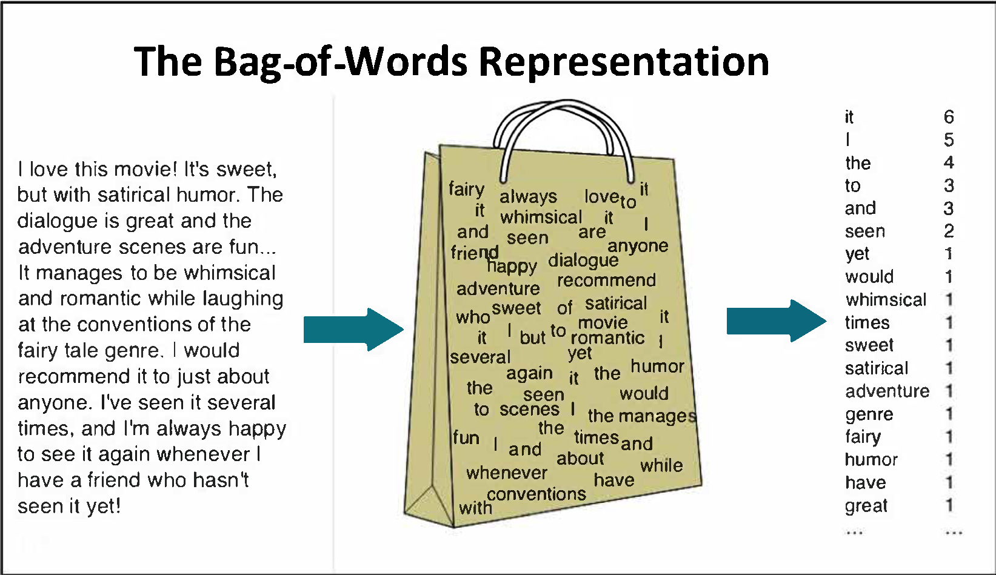
TF: Bag-of-Words Model
The methods used for term frequency use a “bag of words” approach.
Each document is represented by a “bag of words” in which grammar and word order are disregarded, but multiplicity is kept.

Slide 19
Finding TF: CountVectorizer
CountVectorizer is used to convert a collection of text to vectors of token counts.
There are three parameters:
minTF: Sets the minimum term frequency of a word. A value of 1 will ensure all words are included.
minDF: Sets the minimum document frequency of a word. A value of 1 will ensure all words are included.
vocabSize: Limits the size to the top number of words specified. A number greater than or equal to the number of unique words in the corpus will include all words.
The results will be returned in descending values and based on the term’s frequency across the entire corpus, not just the document, and will eliminate words based on parameters

Slide 20
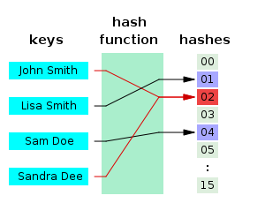
Finding TF: HashingTF
Hashing is the process of transforming data of arbitrary size to a fixed size.
Each word is input in a hash function to give it a number. The same words result in the same hash ID.
Each hash is counted, returning the term frequency for each word.

Slide 21
The IDFModel
After using HashingTF or CountVectorizer to get term frequency, TD–IDF can be calculated by fitting the features with an IDFModel.
The IDFModel scales each column based on feature vectors, which decreases weights on words found in multiple documents.

Slide 22
Class Objectives
By the end of today’s class, you will:
☑ Explain why natural language processing (NLP) is necessary for a big data tool kit.
Apply transformations resulting from NLP data processing to PySpark DataFrames.
Explain and utilize PySpark text-processing methods like tokenization, stop words, n-grams, and term and document frequency.
Describe example steps in an NLP data processing pipeline.

Slide 23
Class Objectives
By the end of today’s class, you will:
☑ Explain why natural language processing (NLP) is necessary for a big data tool kit.
☑ Apply transformations resulting from NLP data processing to PySpark DataFrames.
Explain and utilize PySpark text-processing methods like tokenization, stop words, n-grams, and term and document frequency.
Describe example steps in an NLP data processing pipeline.

Slide 24
Class Objectives
By the end of today’s class, you will:
☑ Explain why natural language processing (NLP) is necessary for a big data tool kit.
☑ Apply transformations resulting from NLP data processing to PySpark DataFrames.
☑ Explain and utilize PySpark text-processing methods like tokenization, stop words, n-grams, and term and document frequency.
Describe example steps in an NLP data processing pipeline.

Slide 25
Class Objectives
By the end of today’s class, you will:
☑ Explain why natural language processing (NLP) is necessary for a big data tool kit.
☑ Apply transformations resulting from NLP data processing to PySpark DataFrames.
☑ Explain and utilize PySpark text-processing methods like tokenization, stop words, n-grams, and term and document frequency.
☑ Describe example steps in an NLP data processing pipeline.

